Slide 1
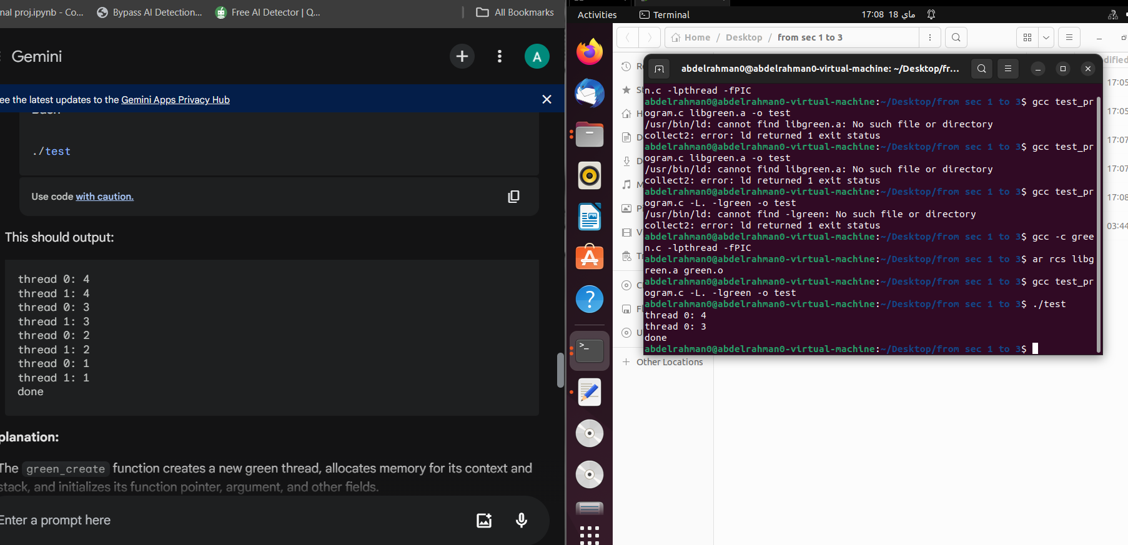

Slide 2
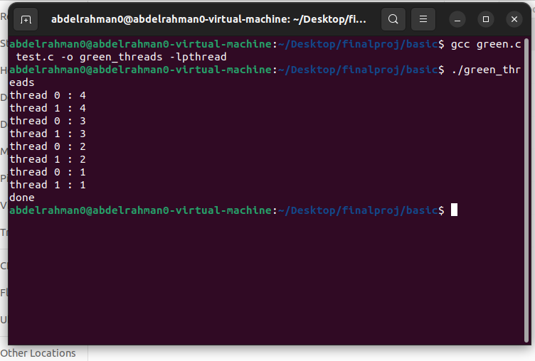
After a lot of coding and debugging this what I came up with this: stage 1

Slide 3
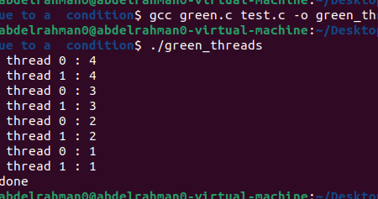
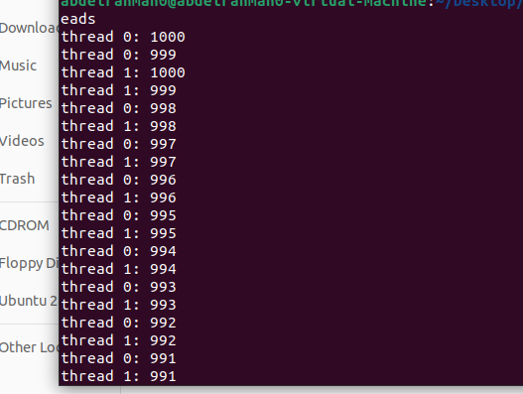
Now we have suspension cond
The behaviour changes completely with the mutex

Slide 4
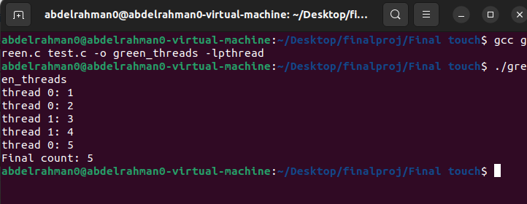
Finally the final touch part worked :

